Slide 1

They called him Mücke

Slide 2
General Facts
110 minutes long
Original language: Italian
Countries of production: Italy and Germany
Release year: 1978
Director: Michele Lupo

Slide 3

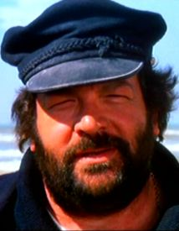
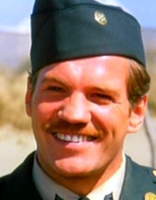
Main Caracters
Mücke (Bud Spencer)
Sergeant Kempfer (Raimund Harmstrof)

Slide 4
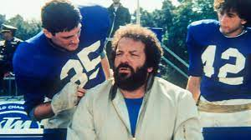
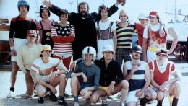
Story
Mückes boat get destroyed by a periscope form a submarine
Want to by a new engine from the US-Army
Sergeant Kempfer recognise Mücke was a good American Football Player
A group of people wants to play against the Armies Football Team
They asked Mücke to play for them, but he only coaches them
They nearly lose so Mücke decided to play

Slide 5
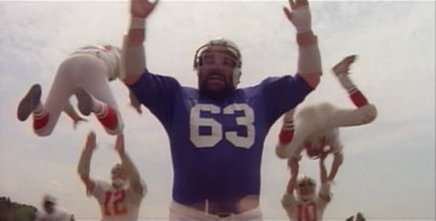
My favorite scene
Mücke ran through the whole enemy team

Slide 6
Pros
Funny to watch
Music

Slide 7
Cons
Sound effects sometimes inapt

Slide 8
Recommendation
If you like Bud Spencer films, YES!

Slide 9
Thanks for listening!

